Slide 1
Unit 8 Graph Linear Inequalities
Algebra 1

Slide 2
Graphing Inequalities in the Coordinate Plane
Graph the Line (Dashed or Solid)
Pick a Point on Either Side of the Line
If the Statement is True, Shade in that Side.
If the Statement is False, Shade the Other Side.
If the line doesn’t go through the origin, pick (0, 0) as a test point.

Slide 4
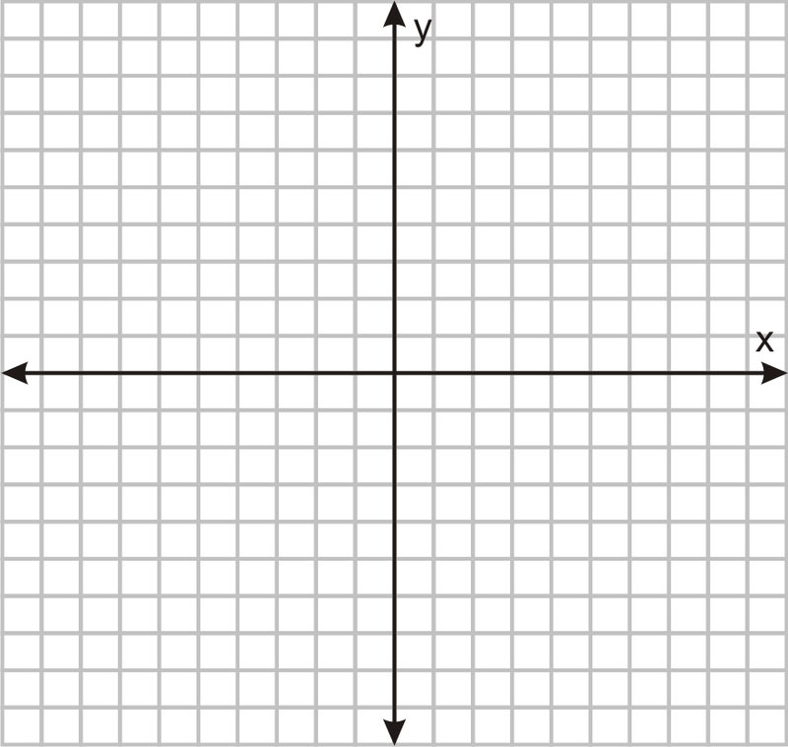
Graph the Inequality
$$x≥4$$
$$y<0$$

Slide 5
Is the Ordered Pair a Solution?
$$y>\frac{2}{3}x+3;(−4, 3)$$

Slide 6
Graph the Inequality
$$y<4x−5$$

Slide 7
Graph the Inequality
$$8x+6y≥10$$

Slide 8
Graph the Inequality
$$3x−7y<−21$$

